Slide 1




Position Paper
18Q15 刘奕雯

Slide 2


CONTENT
Aims
Structure
Details
Tips

Slide 3
Aims
Display of your preparation
First impression
Show your potential leadership…
Basis of your opening speech
Award!

Slide 4
Headings (Times New Roman 12-12.5 Bold)
Structure
Committee: Legal Committee
Topic : Rights of Indigenous Peoples
Country: The Republic of Peru
Delegate: Ertai E, Yiwen Liu
School: Harbin No.3 High School
SINGLE
DOUBLE

Slide 5
Structure
(approximately 400 words in total
Times New Roman 12-12.5)
A. Background of the Topic
In your country’s opinion, what are the main elements of the problem?
What are the roots of those elements?
B. Position taken by your delegation
What are your national interests in the situation?
What are your nation’s policies on the topic?
(what has your country done or said about this topic, both domestically and internationally?)
What steps would you like to see taken to deal with the problem?

Slide 6
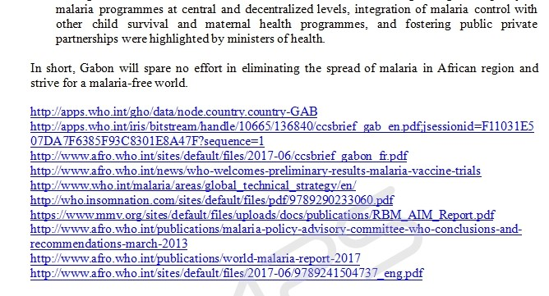
Structure
(approximately 400 words in total
Times New Roman 12-12.5)
C. Proposed Solutions
What does your nation believe needs to be done to solve the problem?
What do you predict will be the main opposition to your proposals?
D. Bibliography

Slide 7
Details
1
Simple and Logical
减少定语从句的使用
多使用分词形式，减少复合句的使用
☹ France would maintain consultation with other countries and France would solve the issue, which is a current one, in an appropriate way with other countries.
☺France would maintain consultation with other countries to make the current issue well-solved.
☹ The resolution of implementing economic sanctions on Iran, though opposed by many Islamic countries, was passed by the Security Council.
☺ Although many Islamic countries opposed it, the resolution which supports to implement economic sanctions on Iran was passed by the Security Council.

Slide 8
Details
2
Make it official
以本国的国家利益为核心，鲜明地阐述本国对该问题的立场
避免过于空泛或不切实际的建议，提出的解决问题的建议不仅要符合本国利益，而且要切实可行
☹U.S. thinks all the countries should spare no efforts to combat terrorism.
☺U.S. suggests counter-terrorism policy be set up and supported by all the countries as no efforts should be spared to combat terrorism.

Slide 9
Details
3
Organized and Precise
Some logical link verbs:
In addition/ Additionally In that regard
In accordance with our fully participation To ensure the authority of As is mentioned in
With the aim to With the awareness of
In collaboration with
☹China started resolution 2270 and it was commonly agreed.
☺China co-sponsored resolution 2270 and it was unanimously adopted.

Slide 10
Tips
PP的主语如用第一人称，一定要注意用We, 而不是I。
PP的格式
1）法律条文最好斜体，如决议案：A/RES/52/199
2）在某个组织或会议第一次出现时，要写上全名+（缩写名）； 后提到则用缩写。例如：World Health Organization ( WHO)
选词
1) 要注意学术性——选用正式、学术的词汇。
2) 要注意多样性——表达同一个意思的词语最好不同的换着用
明确立场文件与第一轮演讲的关系
Written-Formal Oral-Informal
立场文件要切合国家身份。

Slide 11
Thank you for your listening
校内会PP ddl: 9月21号校内会Session1

